Slide 1
From MTV, Back to politics
1980s

Slide 2
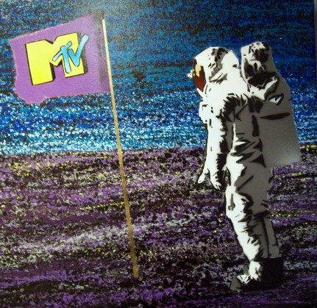
MUSIC TELEVISION MTV
Founded on 1 August 1981.
https://www.youtube.com/watch?v=XBf0yJVMSzI
To play music videos, introduced by video jockeys.
The Buggles, “Video killed the radio star”: https://www.youtube.com/watch?v=Iwuy4hHO3YQ
Disrupted radio’s dominance; changed record selection (e.g. Men at Work).
Now mostly reality, drama, and comedy shows with a few music videos
By 2015, 80% of USA households subscribe to MTV.

Slide 3
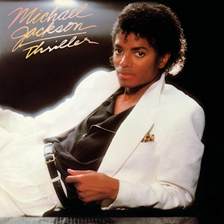
Michael Jackson, 1958-2009
Started in Jackson Five at age six.
1971: Started solo career
1975: The Wiz, played Scarecrow, met Quincy Jones.
1979: Off the Wall, first major album
“Don’t Stop till you get enough”:
https://www.youtube.com/watch?v=yURRmWtbTbo

Slide 4
Michael Jackson, 1958-2009
1982: Thriller, as much a video set as an album.
https://www.youtube.com/watch?v=Cd-I-iamrJM
Seven singles, all of them reached the top 10 on the Billboard Hot 100.
Three videos: “Billie Jean”, “Thriller,” “Beat it!”
“Beat it”: https://www.youtube.com/watch?v=oRdxUFDoQe0
Ended gang violence?
Thriller was best-selling album of 1983, became best-selling album of all time all world, about 65 million altogether.
Lots of controversies…
Death ruled a homicide by his personal doctor.

Slide 5
U2
Formed in 1976 in Dublin:
Paul David Hewson / Bono (vocals and rhythm guitar)
David Howell Evans / the Edge (lead guitar, keyboards, and vocals)
Adam Clayton (bass guitar)
Larry Mullen, Jr. (drums and percussion)
Name was chosen from a friend’s list, least hated, ambiguous.
Boy, 1980
“I will follow”: https://www.youtube.com/watch?v=g2BqLlVHlWA
October, 1981

Slide 6
U2
War, 1983
Explicitly political and harsh sound, clashed with synthpop and dance music.
“Sunday Bloody Sunday”
https://www.youtube.com/watch?v=lVj7J-78Gu8
“New Year’s Day”
“Two Hearts Beat as one”
Unforgettable Fire, 1984
Brian Eno (Roxy Music) and Daniel Lanois produced.
Mystical, ethereal, ambivalent lyrics, except biggest hit:
Biggest hit: “Pride (In the name of love)”
https://www.youtube.com/watch?v=LHcP4MWABGY

Slide 7
Dire Straits, 1977-1988, 1991-1995
Mark Knopfler (lead vocals, guitar)
David Knopfler (rhythm guitar, vocals)
John Illsley (bass guitar, vocals)
Pick Withers (drums and percussion)
Jazz, folk, blues, and pub rock influences; not punk rock, in the age of punk and post-punk.
First big hit, “Sultans of Swing,” 1977, reached no. 4 in USA and no. 8 in UK.
First album, Dire Straits, 1978 reached top 10 in every west European country.

Slide 8
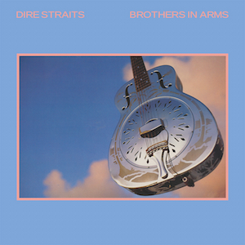
Dire Straits, 1977-1988, 1991-1995
Making Movies, 1980: “Skateaway,” “Romeo and Juliet,” “Tunnel of Love”.
Brothers in Arms, 1985: several number one singles, especially “Money for Nothing”:
https://www.youtube.com/watch?v=wTP2RUD_cL0
Knopfler was reluctant.
First computer-generated animation.
Launched MTV Europe in 1987.

Slide 9

Genesis, 1967-1998
Originally led by Peter Gabriel, Mike Rutherford, and Tony Banks.
1974: Gabriel left.
Drummer Phil Collins (joined in 1970) gradually became main song-writer and singer.
1986: Invisible Touch, first top-selling album, with single and video: “Land of Confusion”
https://www.youtube.com/watch?v=TlBIa8z_Mts

Slide 10
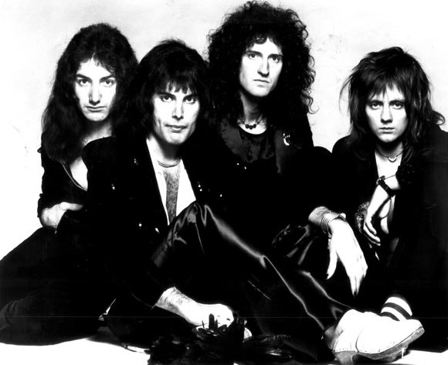
Queen, 1970-1991, 1995…
Brian May (guitars)
Freddie Mercury (Farrokh Bulsara), vocals, main songwriter
John Deacon (bass guitar)
Roger Taylor (drums)
Initially, progressive rock with some heavy metal influences.
First major album, Sheer Heart Attack, 1974, with single “Killer Queen”.
1975: Night at the Opera, with single “Bohemian Rhapsody”.
Many hits, especially:
"Bohemian Rhapsody," "Killer Queen," "Somebody to Love," "Don't Stop Me Now," "Crazy Little Thing Called Love," and "We Are the Champions."

Slide 11
Queen, 1970-1991, 1995…
Amazing live performances
Toured South America, Australia, Japan, willing to go anywhere to play.
13 July 1985, Live Aid performance:
https://www.youtube.com/watch?v=TkFHYODzRTs
1986, Budapest, behind the Iron Curtain:
https://www.youtube.com/watch?v=iCV3mqiPluA&list=RDLVwtLT9D9Pk&index=3
1990: Innuendo: https://www.youtube.com/watch?v=g2N0TkfrQhY
November 1991, Freddie Mercury died of complications from AIDS.

Slide 12
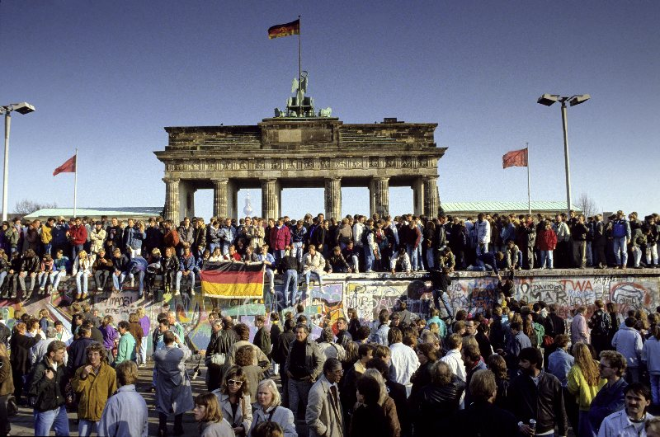
End of Communism in Europe, 1989-1991
1990: Jesus Jones, “Right here, right now”:
https://www.youtube.com/watch?v=lwpjsToHzAE

Slide 13
Grunge, 1985-1995
Based in Washington state, mostly Seattle:
Record label: Sub Pop
Songs about teenage angst, alienation, apathy, confinement, rebellion
Soundgarden, 1984-1997: Chris Cornell (guitar and vocals), Kim Thayill (lead guitar), Hiro Yamamoto (bass), Matt Cameron (drums)
Superunknown, “Black Hole Sun”, 1994
https://www.youtube.com/watch?v=TZThOsCv2Mw
Nirvana, 1987-1994: Kurt Cobain (guitar, song-writer, vocals), Krist Novoselic (bass), Chad Channing (drums for Bleach), then David Grohl (drums for rest of existence).
Nevermind (1991), “Smells like teen spirit” (Pixies Rip-off), “Come as you are,” “Lithium,” and “In Bloom”.
https://www.youtube.com/watch?v=zYxkezUr8MQ
Pearl Jam, Alice in Chains, Stone Temple Pilots

Slide 14
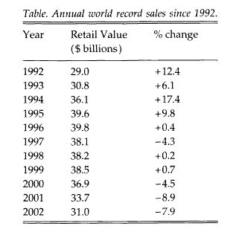
Decline of Record sales world wide
Notes:
Laing, Dave. 2004. “World Record Sales 1992-2002”. Popular Music 23 (1). Cambridge University Press: 88–89. http://www.jstor.org/stable/3877630.

Slide 15
Causes of Decline of Record sales world wide
Other entertainment outlets:
Video games, cell phones
CD burning of albums (started earlier with cassette tapes)
P2P sharing (bittorrent)
Notes:
Laing, Dave. 2004. “World Record Sales 1992-2002”. Popular Music 23 (1). Cambridge University Press: 88–89. http://www.jstor.org/stable/3877630.

Slide 16


More recent developments….
1979, Usenet began some file sharing, especially after linked to ARPANET.
1991: World Wide Web
Napster, from June 1999 to July 2001,
P2P (peer-to-peer) shared mp3 files, undermined albums/CDs.
At its peak, about 80 million registered users.
Metallica, “I Disappear”, circulated before released. Sued Napster.
Limewire, 2000-2010
Bittorrent persisted, especially Piratebay.
Steve Jobs, iTunes (2001 to present), better than nothing argument.

